Slide 1

A Visualization for
Discrete Stratified Morse Theory
CS6965 Advanced Data Visualization
Yulong Liang
The University of Utah

Slide 2
ORIENTATION
Background
1
4
demonstration
Theoretical details
2
5
CHALLENGES
Technical details
3
6
FUTURE PLAN
Notes:
This is the outline of my presentation today.

Slide 3
01
PART I
BACKGROUND
Notes:
Well, transition is change.
Firstly, let’s review how women’s status in China has changed during China’s long history.

Slide 4
1
PART
ONE
BACKGROUND
Classic Morse Theory
Classical Morse Theory is a mathematical technique which was introduced by Marston Morse. It enables one to analyze the topology of a manifold by studying differentiable functions on that manifold. Morse theory allows one to find CW structures and handle decompositions on manifolds and to obtain substantial information about their homology.
Classic Morse Theory

Slide 6
1
PART
ONE
BACKGROUND
Discrete Morse Theory
Discrete Morse Theory is a combinatorial adaptation of Morse theory developed by Robin Forman. Instead of a manifold which is continuous, it analyzes the topology of a simplicial complex which is discrete. Discrete Morse Theory allows one to find critical simplices, remove non-critical simplices and simplify the original simplicial complex.
Discrete Morse Theory

Slide 8
1
PART
ONE
BACKGROUND
Discrete Stratified
Morse Theory
Stratified Discrete Morse Theory a refinement of Discrete Morse Theory proposed by Kevin Knudson and Bei Wang. It expands the usage of Discrete Morse Theory from simplicial complex with Discrete Morse Function to simplicial complex with any function value.
Discrete Stratified Morse Theory

Slide 9
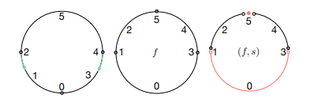

Slide 10
02
PART II
THEORETICAL DETAILS

Slide 11
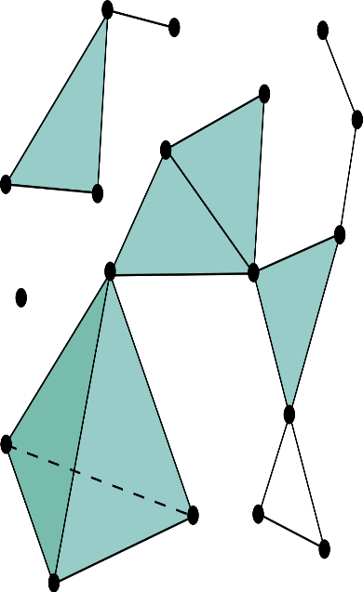
甚至，
推销
赢得
还可以
SIMPLICIAL COMPLEX
商品或服务
一笔商业投资
感染现场观众
Notes:
China was a feudal society for more than 2 thousands years, under the dominant influence of Confucianism.
Women had to be subject to the male figures throughout their lifetime.

Slide 12



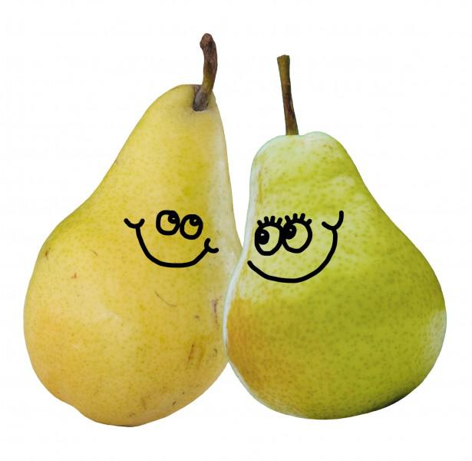
REMOVAL
WE ARE DONE!
By removing all the non-critical pairs
MARK NONCRITICAL PAIRS
一笔商业投资
感染现场观众
SIMPLICIAL COMPLEX
商品或服务
MARK NONVIOLATOR CRITICALS
MARK VIOLATORS
We can keep the original shape of the data with fewer simplices
Notes:
From 1912, women’s status was improved substantially during China’s short Republican Era.
Since 1949, Chairman Mao proposed that “women should hold up half the sky”, which is the propaganda of Chinese government for women.
In modern society, especially 21st century, women have acquired increasingly more rights in political, economic and social life.

Slide 13

CRITERION
并非所有的演示
都能达到理想的效果
GENDER EQUALITY
STILL remains a long-standing goal in the long run.
When could women truly “Holding Half the Sky”?

Slide 14
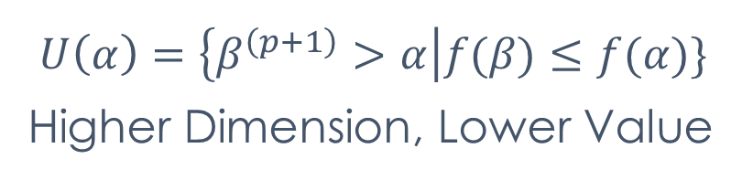
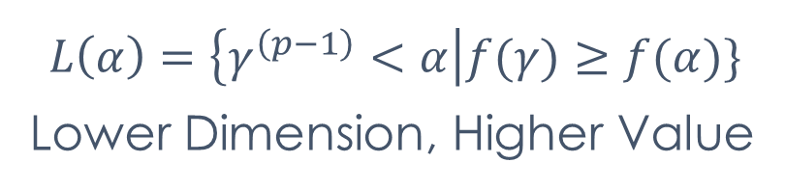
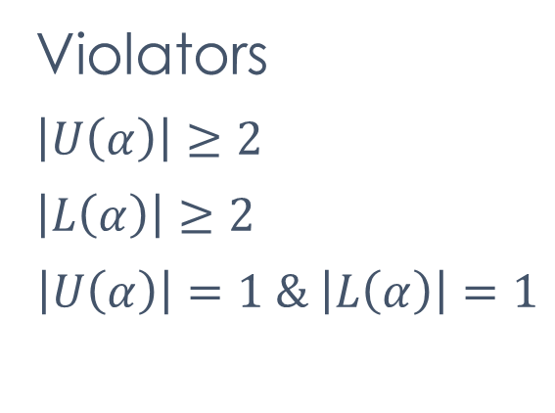
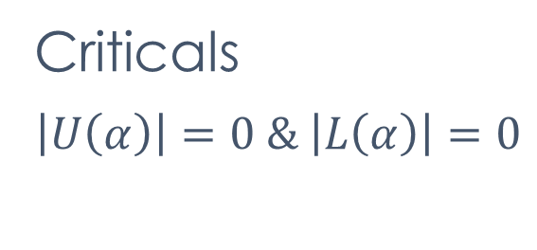
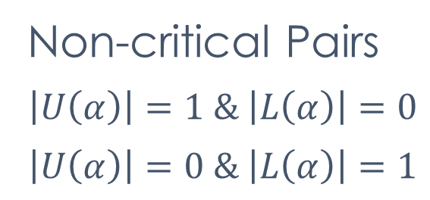
2
PART
TWO
THEORETICAL DETAILS
Violators
$$\left|U\left(α\right)\right|≥2$$
$$\left|L\left(α\right)\right|≥2$$
$$\left|U\left(α\right)\right|=1 \& \left|L\left(α\right)\right|=1$$
$$U\left(α\right)=\left\{β^{\left(p+1\right)}>α\right|f(β)≤f(α)\}$$
Higher Dimension, Lower Value
Criticals
$$\left|U\left(α\right)\right|=0 \& \left|L\left(α\right)\right|=0$$
$$L\left(α\right)=\left\{γ^{\left(p−1\right)}<α\right|f(γ)≥f(α)\}$$
Lower Dimension, Higher Value
Non-critical Pairs
$$\left|U\left(α\right)\right|=1 \& \left|L\left(α\right)\right|=0$$
$$\left|U\left(α\right)\right|=0 \& \left|L\left(α\right)\right|=1$$
Notes:
The approach of CDA is utilized, which deals with “social power abuse, dominance and inequality”, involving how they are enacted, reproduced, and resisted by textual information.
CL is also adopted, which studies a large collection of texts, aided by computer technology to avoid “cherry-picking”.
In this paper, I would focus on collocations which are the co-occurred words of certain search term, which contain the semantic profile of search term.
The semantic prosody would also be focused, which provides the attitude associated with lexical items, either positive or negative.
Notably, a combined approach is used, which makes them benefit from each other, to ensure both the qualitative and quantitative perspectives.

Slide 15
2
PART
TWO
THEORETICAL DETAILS
Violators
$$\left|U\left(α\right)\right|≥2$$
$$\left|L\left(α\right)\right|≥2$$
$$\left|U\left(α\right)\right|=1 \& \left|L\left(α\right)\right|=1$$
Criticals
$$\left|U\left(α\right)\right|=0 \& \left|L\left(α\right)\right|=0$$
Non-critical Pairs
$$\left|U\left(α\right)\right|=1 \& \left|L\left(α\right)\right|=0$$
$$\left|U\left(α\right)\right|=0 \& \left|L\left(α\right)\right|=1$$
Notes:
The approach of CDA is utilized, which deals with “social power abuse, dominance and inequality”, involving how they are enacted, reproduced, and resisted by textual information.
CL is also adopted, which studies a large collection of texts, aided by computer technology to avoid “cherry-picking”.
In this paper, I would focus on collocations which are the co-occurred words of certain search term, which contain the semantic profile of search term.
The semantic prosody would also be focused, which provides the attitude associated with lexical items, either positive or negative.
Notably, a combined approach is used, which makes them benefit from each other, to ensure both the qualitative and quantitative perspectives.

Slide 16
03
PART III
TECHNICAL DETAILS

Slide 17
3
PART
THREE
TECHNICAL DETAILS
B
HTML/CSS
H
Bootstrap
D
JavaScript
J
D3.js

Slide 18
DATA FORMAT

Slide 19
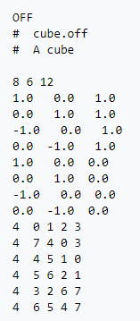
OFF (Object File Format)
DATA FORMAT
Notes:
An online newspaper archive, LexisNexis, is used to collect the data.

Slide 20
DATA STRUCTURE

Slide 21
Linked List
DATA STRUCTURE
V
E
F
Notes:
An online newspaper archive, LexisNexis, is used to collect the data.

Slide 22
ALGORITHMS

Slide 23
V1 vs V2
Notes:
An online newspaper archive, LexisNexis, is used to collect the data.

Slide 24
04
PART IV
DEMONSTRATION

Slide 25
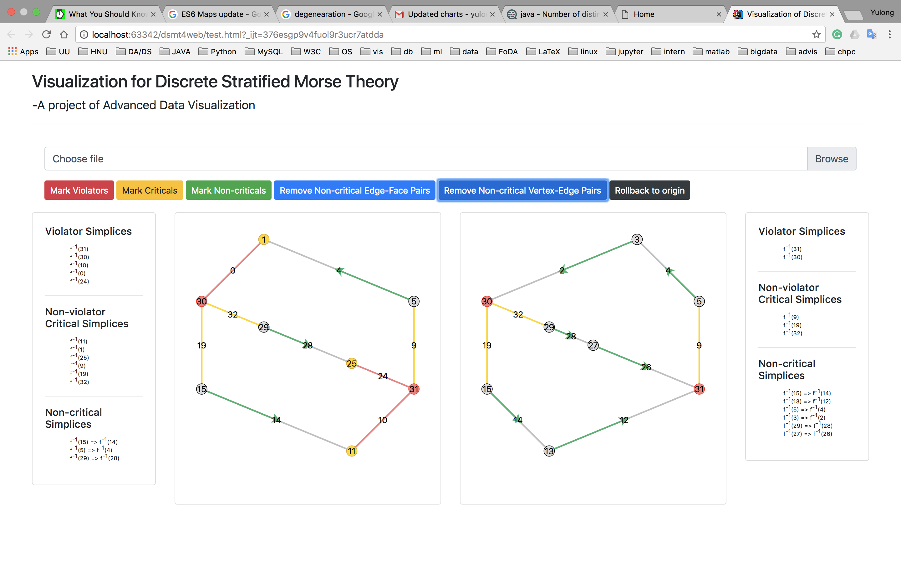

Slide 26
05
PART V
CHALLENGES

Slide 27
这可能是因为
Overlapping
SVG group to predefine the order

Slide 28
这可能是因为
Text Position
Vertices: same position
Edges: middle point
Faces: geographic median

Slide 29
这可能是因为
Arrow Drawing
Preparation: predefined path for arrow head
Appending: from vertex to text

Slide 30
这可能是因为
Animation for Non-critical Vertex-Edge Pairs Removal
Stage 1: Moving vertex to the new position
Stage 2: Reset the points of its arms & wings
Stage 3: Remove the vertex

Slide 31
这可能是因为
Coordinates for Non-critical Vertex-Edge Pairs Removal
Starting from violator and critical vertices
Using BFS to pull the adjacent non-critical pairs

Slide 32
这可能是因为
Corner Cases
Self-looping edge
Collinear edge check and calculate path first
Degenerated face

Slide 33
这可能是因为
Curves Path Calculation
P
A
A
B
P

Slide 34
06
PART VI
FUTURE PLAN

Slide 35
There is still something left to be improved...
Notes:
In this part, USAS broad categories with most collocates in each corpus would be examined, which is the category A, N and T.

Slide 36
Future Plans
1
Using a slider with scales to control the steps in the pipeline of simplification.
2
Using 3d instead of 2d visualization, treating function value as elevation.
3
Implementing a plugin for TTK.
Notes:
Statistically, they are actually the top three categories.

Slide 37


ありがとう
Спасибо
Merci
고맙습니다
Q&A
Grazie
Gracias
Danke
Thanks
謝謝

